Slide 1
US Government
USI 7 a,b

Slide 2
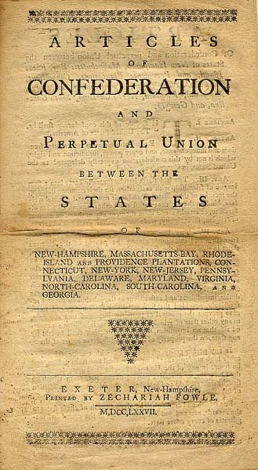


Articles of Confederation
First plan of government for America
Not very good

Slide 3


Problems with Articles of Confederations
not strong
Weak national government
No power to tax or control trade
No common currency

Slide 4
Each state had 1 vote no matter how big
No executive or judicial branch

Slide 5
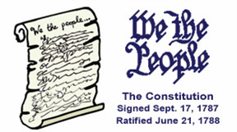
Confederation to Constitution
Weaknesses in the Articles of Confederation led to the effort to draft a new constitution

Slide 6

Constitutional Convention
Delegates met in Philadelphia to revise the Articles
Decided to write a new constitution
George Washington elected president of the Constitutional Convention

Slide 7
Strong
Delegates debated over how much power should be given to the new government
Debated over how large and small states should be represented in the new government
Not Strong

Slide 8
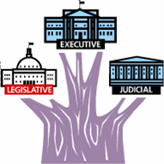
Structure of New National Government
Called for 3 separate branches of government
  Legislative
  Executive
  Judicial

Slide 9

Federal System of Government
Divides government power between national government and state government
national
state

Slide 10
Great Compromise
Decided how many votes each state had in the Senate and the House of Representatives

Slide 11
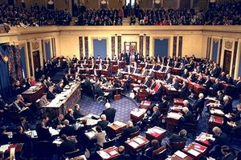
Senate
SAME

Slide 12
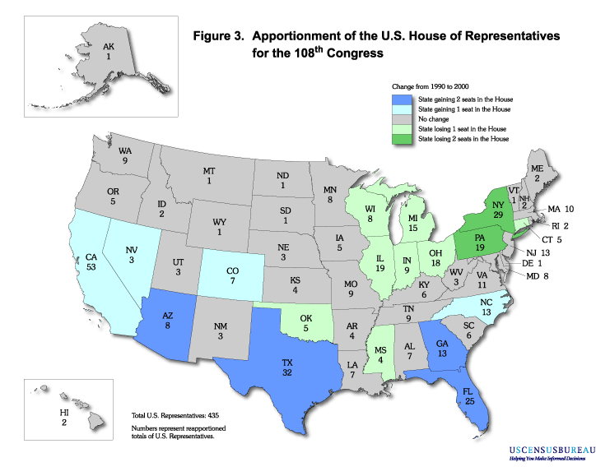
House of Representatives
POPulation

Slide 13
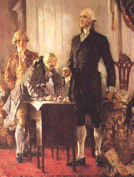

Ratification of the Constitution
The Constitution was signed at the end of the convention
9 of the 13 states had to vote in favor of the Constitution before it could become law

Slide 14
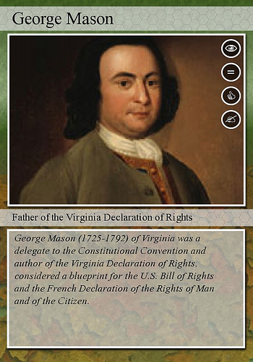

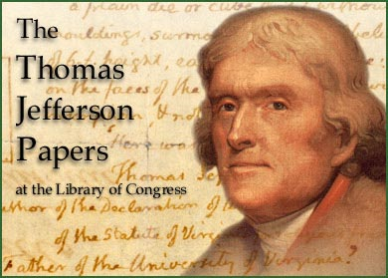
Bill of Rights
Based on the Virginia Declaration of Rights (George Mason) and the Virginia Statute for Religious Freedom (Thomas Jefferson)

Slide 15
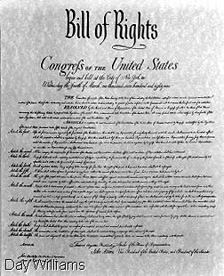
Bill of Rights
The first 10 amendments to the Constitution
Provided a written guarantee of individual rights
Examples:
  Freedom of speech
  Freedom of religion

